Slide 1
Business Modeling - Domain Analysis
Most materials taken from the RUP textbook Chapter 8
25

Slide 2
Purpose of Business Modeling
To understand the structure and dynamics of the organization in which a system is to be deployed
To understand current problems in the target organization and identify areas for potential improvement
To ensure customers, end users, and developers have a common understanding of the target organization
➔Note: all about the organization and not the application (directly).
25

Slide 3
Business Modeling (Domain Analysis)
➔We look at WHY we even look at business modeling before application development.
Need to create a model of the ‘vision’ of the target organization (if not already available) –with its
  Processes
  Roles
  Responsibilities
  (What do they do? What are they about? Customers?)
Three primary components: (Much more ahead)
  ➔ Business Use Case Model, and
  Business Object Model
  ➔ A Domain Model
  We will discuss each in turn several slides ahead…
25

Slide 4
Why Undertake Business Modeling
(Why do we care? – 1 of 2 )
The new standard for software development is understand the business domain before or in parallel with development of an application.
  Applications must ‘fit’ within the organization!
Business modeling
  A recognized, central part of development, and, in particular, facilitates the development of Requirements.
  Now involves higher level people; those who can have an appreciation of the overall organization and major cost centers therein.
  Involves some decision makers.
    Especially regarding decisions involving change
    (not just those who ‘know’ the business well - SMEs).
According to the UP, Business Modeling is the first discipline addressed and is key to acquiring key artifacts that will underpin much future work.
It is also a fundamental discipline in Inception phase.
25

Slide 5
Why Undertake Business Modeling?
(Why do we care? - 2 of 2)
Very important to learn background knowledge so developers
  Can communicate with users and
  Make more intelligent decisions.
  Understanding customer’s problems and
  Setting the scope for a development project that might follow.
➔ Business Modeling (‘Domain Analysis’) is a process by which a software engineer learns background information
  to understand a problem at hand and
  to make good decisions during requirements analysis and other stages of the software engineering process.
The ‘Domain’ – a general field of business or technology.
25

Slide 6
Sources of Domain Knowledge
To perform business modeling (domain analysis), we need to gather information from a number of sources of information.
Seek experts in domain knowledge (SME)
Sources of Domain Knowledge:
  High-level problem statements;
  Overall / Expert Vision of the Enterprise; Documented somewhere…
  All about the organization.
  Any model or document that describes the problem space and the desires and needs of the stakeholders.
    Quarterly reports
    Interviews
    Questionnaires
    Personal Research
    Web pages with services offered or their philosophy, etc…
Lots of times, identification of domain knowledge may require individual research and initiative on the part of an analyst!!
25

Slide 7
Business Modeling - more
➔“No serious software project should be undertaken without a sound domain analysis; a good knowledge of the domain of application considerably increases your chances of success.”
Understand the domain? Easier to press on with requirements analysis to solve the problem – vision of a new/enhanced application.
Recognize that domain analysis never ends, as developers continue to supplement their domain knowledge over time.
25

Slide 8
Categories of Applications
(e-business tools – Know these.)
E-business reflects the nature of the business – represents what the business is all about.
Customer to Business (C2B) – applications that allow you to order goods over the Internet, such as books
Business to Business (B2B) automation of a supply chain across two companies
Business to Customer (B2C): provision of information to (otherwise passive) customers, such as by distributing newsletters.
Customer to Customer (C2C): applications that allow customers to share and exchange information with little input from the service provider, such as for auctions.
25

Slide 9
Terms
Business user – customers, vendors, partners – represented by ‘business actors’
Business processes –
  represented by business use cases;
  business use case realizations
Business workers –roles played by…
Business Entities: ‘Things’ organizations manage/produce.
  Represented by business entities / events organized into business systems.
25

Slide 10
So, how do you model the business?
25

Slide 11
Business Modeling Scenarios
Scenario 1 – Organization Chart
  Build a simple organization chart of business and its processes to get a good understanding of the application you are building.
  Where does the application fit? To which organizations or part of organizations might it impact?
    Emphasis is on ‘the organization.’
  (This is done as part of the software engineering process - perhaps part of the inception phase)
25

Slide 12
Business Modeling Scenarios
Scenario 2 – Domain Modeling
  Build a model of that information (banking, order management) that will be present at the business level.
  Domain Modeling is typically part of the software engineering project and is performed during inception and elaboration phases – but is definitely started in inception and refined in elaboration.
  ➔ We will develop a domain model – among other things in the next deliverable. (See next slide lecture plus assigned readings.)
  ➔ Recognize that the Domain Model is part of Domain Analysis (that is, the Domain Model is a component of Business Modeling)
25

Slide 13
Following slide is an example (has a few errors in it) that you may
use as a guide.
These slides were borrowed from next lecture. You will see them again.
See also my web page…
25

Slide 14
Domain Model
More database notation
here (cardinality; modality)
SYSTEM_USER
Member_ID
System_User_Password
System_User_Title
MEMBER
Member_ID
Member_Type_Number
Member_First_Name
Member_Middle_Initial
Member_Last_Name
Member_Address
Member_City
Member_State
Member_Zip_Code
Member_Phone_Number
Member_Email
University_ID_Number
UNIVERSITY
University_ID_Number
University_Name
University_Address
University_City
University_Zip_Code
Is an authorized
Belogs to
MEMBER_TYPE
Member_Type_Number
Member_Type_Description
Is categorized as
manages
FINANCE
Financial_ID_Number
Financial_Date
Member_ID
Financial_Amount
Financial_Desc
Payment_Type_ID
places
VENDOR
Vendor_Number
Vendor_Name
Vendor_Address
Vendor_City
Vendor_State
Vendor_Zip_Code
Vendor_Phone
SALE_ORDER
SO_Order_Number
SL_Line_Number
SO_Order_Date
Member_ID
MEMORABILIA_INVENTORY
Item_Number
Item_Description
Cost_To_Member
tracks
PAYMENT_TYPE
Payment_Type_ID
Payment_Type_Desc
Is generated for
contains
provides
references
SUPPLIES
Supply_Number
Vendor_Number
Item_Number
Cost_To_UPE
REPLENISH_LINE
RL_Line_Number
Supply_Number
RL_Line_Quantity
SALE_LINE
SL_Line_Number
Item_Number
REPLENISH_ORDER
RO_Order_Number
RL_Line_Number
RO_Order_Date
25
Is generated for
identifies

Slide 15
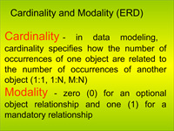
25

Slide 16
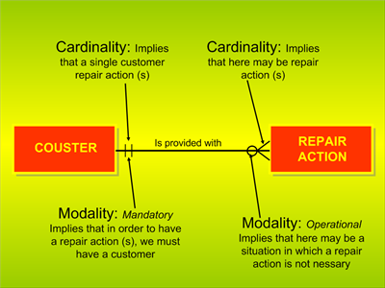
25

Slide 17
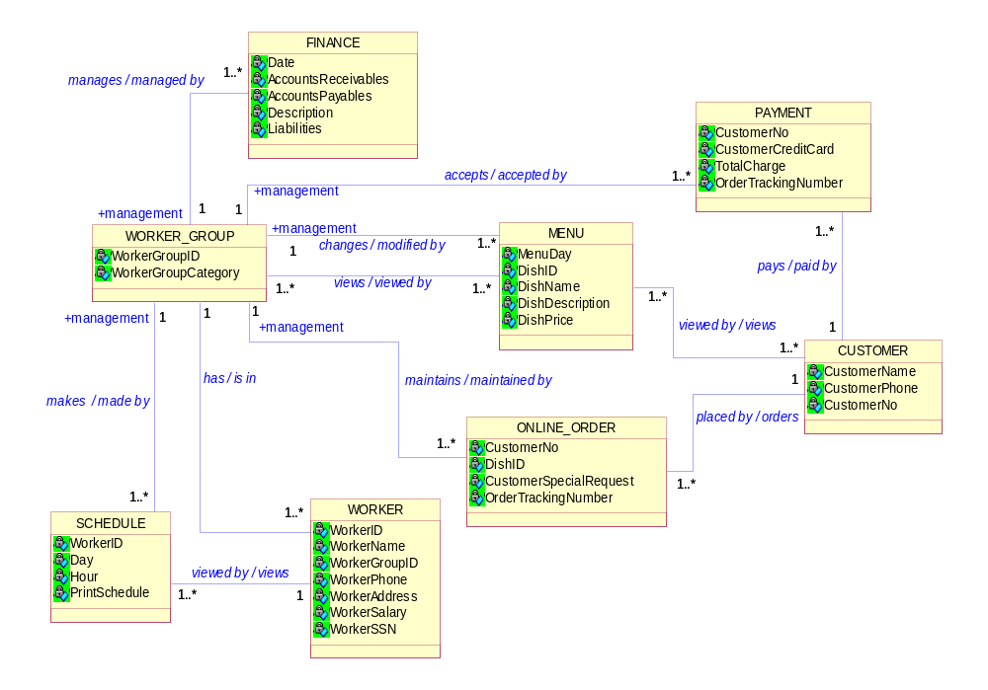
Another example: note the associations; attributes;
roles, multiplicities, etc. Note the ‘core abstractions.’
25

Slide 18
Business Modeling Scenarios
Scenario 3 – One Business; Many systems.
  ➔ One business-modeling effort that is input to several other development projects.
  The business models will as serve as inputs to building the architecture of the application family.
  Individual applications may then use this model for individual projects, and will use this system as a baseline or domain, which may be then tailored or used in a dependency role.
  This business modeling effort is a project by itself!
25

Slide 19
Business Modeling Scenarios
Scenario 4 – Generic Business Model (for different organizations)
  Important if you are building a single, general model to be used to align several organizations within the business
    used to reduce overall complexity - or at least understand how the different organizations might use the application.
Scenario 5 – New Business
  Necessary business modeling for a new line of businesses
25

Slide 20
Business Modeling Scenarios
Scenario 6 – Revamp: Business Process Reengineering (BPR)
  A complete redo of the way of doing business.
    Done in several discrete stages
      Envision new business,
      Reverse engineer existing business,
      Forward-engineer new business, and
      Install new business…
  A revolutionary approach to reorganization….
25

Slide 21
Primary Artifacts developed during Business Modeling
➔ Business Vision Document
  Defines objectives and goals of the business modeling effort
➔ Business Use Case Model
  A model of the business’s intended functions.
  Used as an essential input to identify roles and deliverables in the organization.
  Will be very useful in your development use case modeling for application development.
Business Object Model (Business Analysis Model)
  A model that realizes the business use cases.
  (We will not do this in this course)
25

Slide 22
Primary Artifacts developed during Business Modeling
➔ Business Rules – policies/conditions that must be satisfied; heuristics during operations;
➔ Business Glossary – definitions of important terms that are important to the business (acronyms, as HELOC, … commonly used terms.)
➔ Domain Model – captures core abstractions / business entities – in the organization. (Deliverable 2)
Others – selected…(several omitted are important, but we are concentrating on these☺)
Artifacts in more detail: ➔
25

Slide 23
Business Models
➔ 1. Business Use Case Model:
  Contains business actors (roles external to the business such as customers, existing systems, devices, triggers, etc.) and
  Contains business use cases (business processes) (Business Use Case Diagrams plus specifications) See textbook for examples and web page.
2. Business Object Model (again, not doing this one this semester)
  Includes the business use case realizations
    Includes interacting roles and entities involved.
➔ 3. Domain Model - ahead
These are at higher levels of abstraction than application use cases will be.
  e.g. A class at business level represents a responsibility in an organization. A class represents a business entity, such as Customer, Book, Inventory Item, Salesperson, etc.
25

Slide 24
1. Business Use Case Model
Simple in structure . See pp 151-152 in the RUP.
  Shows relationship between business use cases – in general and business users (business actors).
    A few small business use case diagrams are shown.
  Each use case is identified and actors who interact with this and each business use case.
25

Slide 25
2. Business Object Model
Much more detailed than the business use case model (pg 151-152)
  Each business use case is realized with business actors and business entities.
  Remember: this is all about the “organization!”
  These business entities may (some) then likely be found in the Domain Model (ahead)
25

Slide 26
More details on Business Object Model
Business Models and Entity Classes in domain model.
  A business entity that is to be managed by an information system will correspond to an entity in the domain model as stated.
  Example entities might include:
    Menu
    Work Schedule
    Food Order
    Account
    Loan
    Course …
25

Slide 27
Closing Remarks
➔ Major Thrust of Domain Analysis is developing models such as those captured via Visual Models often – to reflect the organization
➔ Artifacts developed are very essential.
All will greatly assist in effective requirements analysis (gathering, capturing, modeling user requirements, and understanding! ).
Let’s look at the Domain Model.
25

